Slide 1
1007作業

Slide 2
11. 請查詢薪資大於Linda (Employees.EngName)的所有員工之資料。

Slide 3
11. 請查詢薪資大於Linda (Employees.EngName)的所有員工之資料。
SELECT D.*
FROM Employees D, Employees E
WHERE E.EngName = 'Linda'
AND D.Salary>E.Salary

Slide 4
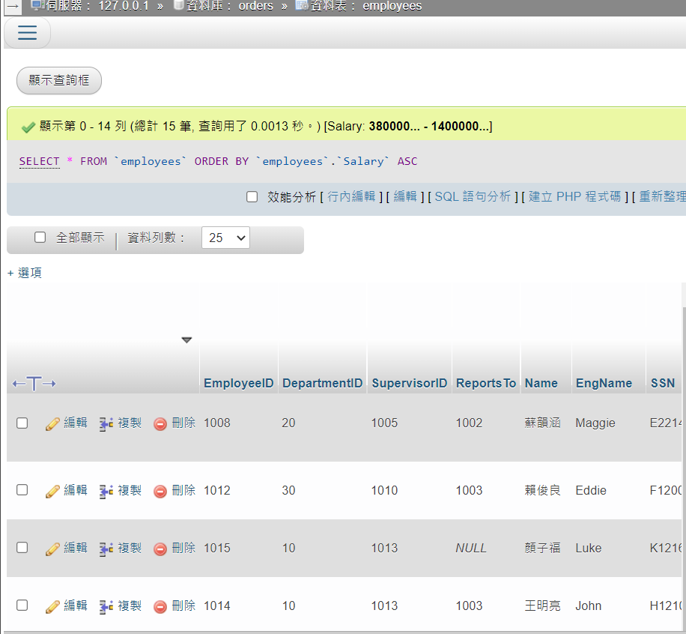

Slide 5
請用UNION聯集查詢
(一)查詢女性(TitleOfCourtesy = '小姐')員工之最高薪資MAX(Salary)之員工資料
(二)查詢男性(TitleOfCourtesy = '先生')員工之最高薪資之員工資料
EmployeeID, DepartmentID, Name, EngName, Salary, Commission, Title

Slide 6
SELECT EmployeeID,DepartmentID,Name,EngName,Salary,Commission,Title
FROM employees
WHERE TitleOfCourtesy ='小姐'
AND Salary=(
SELECT MAX(Salary)
FROM employees
WHERE TitleOfCourtesy = '小姐'
)
UNION
SELECT EmployeeID,DepartmentID,Name,EngName,Salary,Commission,Title
FROM employees
WHERE TitleOfCourtesy ='先生'
AND Salary=(
SELECT MAX(Salary)
FROM employees
WHERE TitleOfCourtesy = '先生'
)

Slide 7
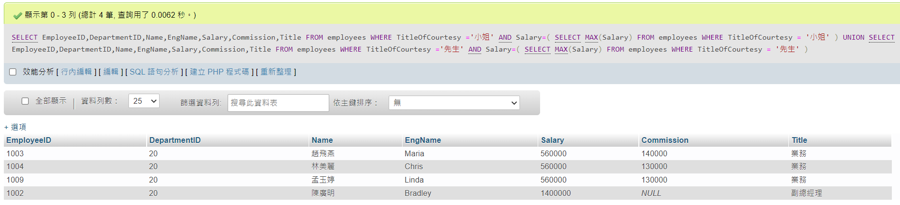

Slide 8
• 請查詢1996年7月份的訂單的訂貨內容
Hint.
1. YEAR(Orders.OrderDate) = 1996
2. SELECT OrderDetails.OrderID, OrderDetails.ProductID,
OrderDetails.UnitPrice, OrderDetails.Quantity, OrderDetails.Discount
From …

Slide 9
SELECT OrderDetails.OrderID, OrderDetails.ProductID,
OrderDetails.UnitPrice, OrderDetails.Quantity, OrderDetails.Discount
From orders NATURAL JOIN orderdetails
WHERE OrderDate BETWEEN '1996-07-01' AND '1996-07-31';

Slide 10
